Slide 1
MT-213: Computing Methods-I

Slide 2
Introduction to Computing Methods
What are COMPUTING METHODS?
Why do we need them?

Slide 3
Computing Methods
Computing Methods:
is study of Algorithms that are used to obtain numerical (approximate) solutions of a mathematical problem.
is concerned with how to solve a problem
numerically, i.e., how to develop a sequence of numerical calculations to get a satisfactory answer.
Why do we need them?
1. No analytical solution exists,
2. An analytical solution is difficult to obtain

Slide 4
What do we need?
Basic Needs in the Computing Methods:
Practical:
Can be computed in a reasonable amount of time.
Accurate:
Good approximate to the true value,
Information about the approximation error (Bounds, error order,… ).

Slide 5
Course Outline:
Taylor Theorem
Number Representation
Error Analysis
Solution of nonlinear Equations in one variable
Solution of system of nonlinear Equations
Interpolation
Solution of system of linear Equations
Operator Analysis
Numerical Differentiation
Numerical Integration
Solution of ordinary differential equations
MATLAB (flow chart,Algo)

Slide 6
Solution of Nonlinear Equations
Some simple equations can be solved analytically:
Many other equations have no analytical solution:

Slide 7
Methods for Solving Nonlinear Equations
Bisection (Bolzono)
Newton-Raphson
Secant Method
Fixed point iteration
Regulai false position

Slide 8
Solution of Systems of Linear Equations

Slide 9
Cramer’s Rule is Not Practical

Slide 10
Methods for Solving Systems of Linear and Nonlinear Equations
Direct method :
upper triangular linear system ,Gaussain Elimination and pivoting , LU decomposition.
Iterative methods :
Gauss-Siedel and Jacobi’s methods
Newton Method , fixed point(Non linear equation )

Slide 11
Interpolation
Given a set of data:
Find a polynomial P(x) whose graph passes through all tabulated points.

Slide 12
Interpolation:
Newton Polynomial Interpolation
Lagrange Interpolation
Taylor polynomial .
Interpolation with equally spaced data, Newton’s Forward and Backward difference .

Slide 13
Integration
Some functions can be integrated analytically:

Slide 14
Methods for Numerical Integration
Upper and Lower Sums
Trapezoidal rule.
Simpson’s rule.
Closed and open Newton-Cotes formulas.
Composite Numerical Integration.

Slide 15
Lecture 2 Number Representation and Accuracy
Number Representation
Normalized Floating Point Representation
Significant Digits
Bits and byte
Accuracy and Precision
Rounding and Chopping
Absolute , relative and percentage error
Reading Assignment:

Slide 16
Algorithm:
To write a logical step-by-step method to solve the problem is called algorithm, in other words,
An algorithm includes calculations, reasoning and data processing.
Algorithms can be presented by natural languages, pseudo code and flowcharts, etc.

Slide 17
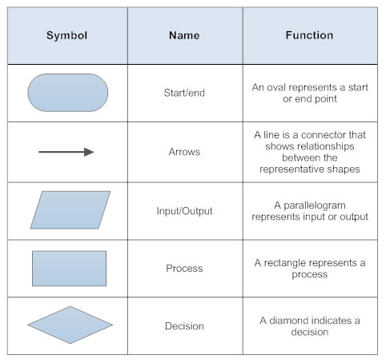
Flow chart :
A flowchart is the graphical or pictorial representation of an algorithm with the help of different symbols

Slide 18
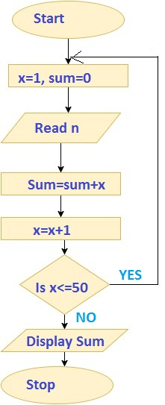
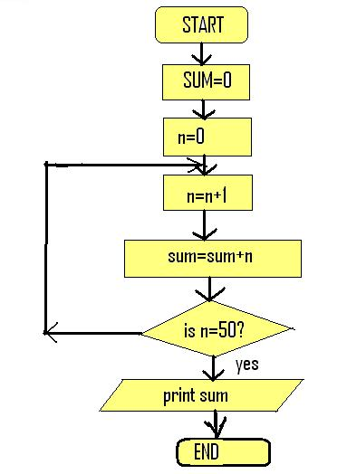
Example:

Slide 19
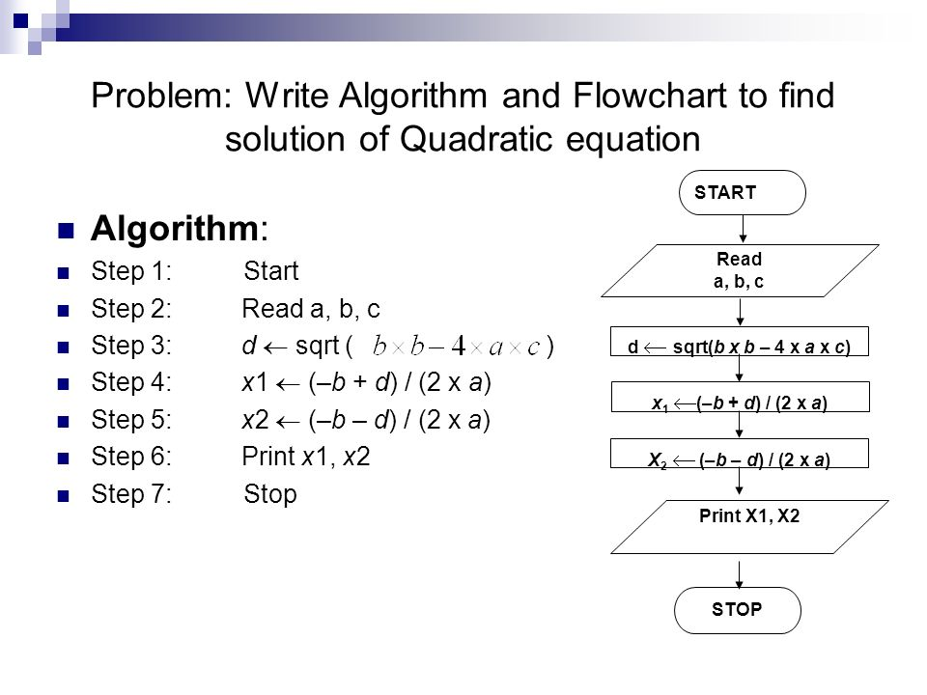
Example:

Slide 20
Representing Real Numbers
You are familiar with the decimal system:
Decimal System: Base = 10 , Digits (0,1,…,9)
Standard Representations:

Slide 21
Normalized Floating Point Representation
Normalized Floating Point Representation:
Scientific Notation: Exactly one non-zero digit appears before decimal point.
Advantage: Efficient in representing very small or very large numbers.

Slide 22
Binary System
Binary System: Base = 2, Digits {0,1}

Slide 23
Fact
Numbers that have a finite expansion in one numbering system may have an infinite expansion in another numbering system:
You can never represent 1.1 exactly in binary system.

Slide 24
IEEE 754 Floating-Point Standard
Single Precision (32-bit representation)
1-bit Sign + 8-bit Exponent + 23-bit Fraction
Double Precision (64-bit representation)
1-bit Sign + 11-bit Exponent + 52-bit Fraction
S
Exponent⁸
Fraction²³
S
Exponent¹¹
Fraction⁵²
(continued)

Slide 25
Rules of significant digits
Non zero numbers are always significant
1.23 45.6 6,7263
In between zeros are always significant
1.005 70206
Leading zeros are never significant
0.0055 0.0302
Trailing zeros are some time significant
70,000 70,000. 1,030 1030.0000

Slide 26
Significant Digits
Significant digits are those digits that can be used with confidence.
Single-Precision: 7 Significant Digits
1.175494… × 10⁻³⁸ to 3.402823… × 10³⁸
Double-Precision: 15 Significant Digits
2.2250738… × 10⁻³⁰⁸ to 1.7976931… × 10³⁰⁸

Slide 27
Single and double precision
Single Precision (32)
23 bits used for significant digits
8 bit used for store exponent
1 bit used for to store sign (+,-)
Double precision: (64 bits)
( 52 for significant digits ,
11 bit for exponent , 1 bit for sign )

Slide 28
Bits and byte :
The byte is a unit of digital information that most commonly consists of eight bits.
Historically, the byte was the number of bits used to encode a single character of text in a computer and for this reason it is the smallest addressable unit of memory in many computer architectures.

Slide 29
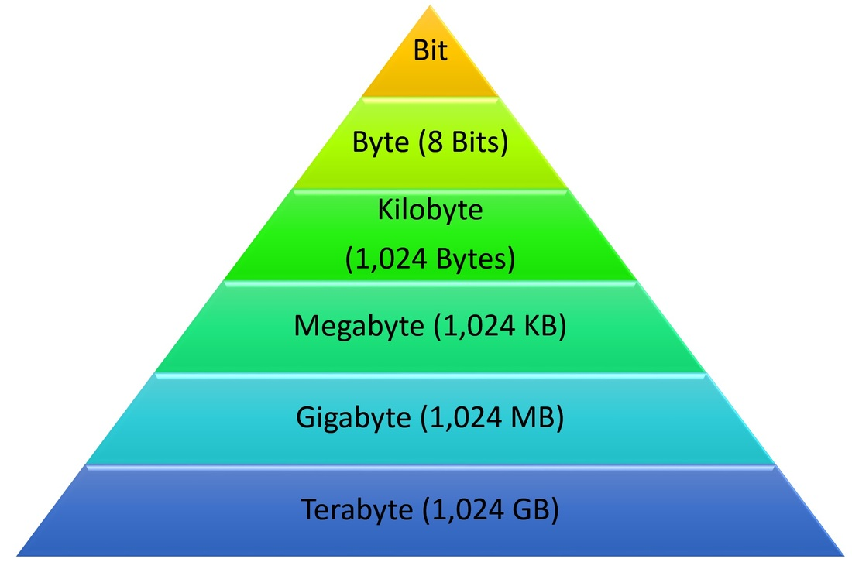
How to Convert Bits and Bytes

Slide 30
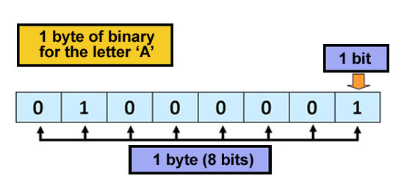
ASCII table :

Slide 31
Accuracy and Precision
Accuracy is related to the closeness to the true value.
Precision is related to the closeness to other estimated values.

Slide 32
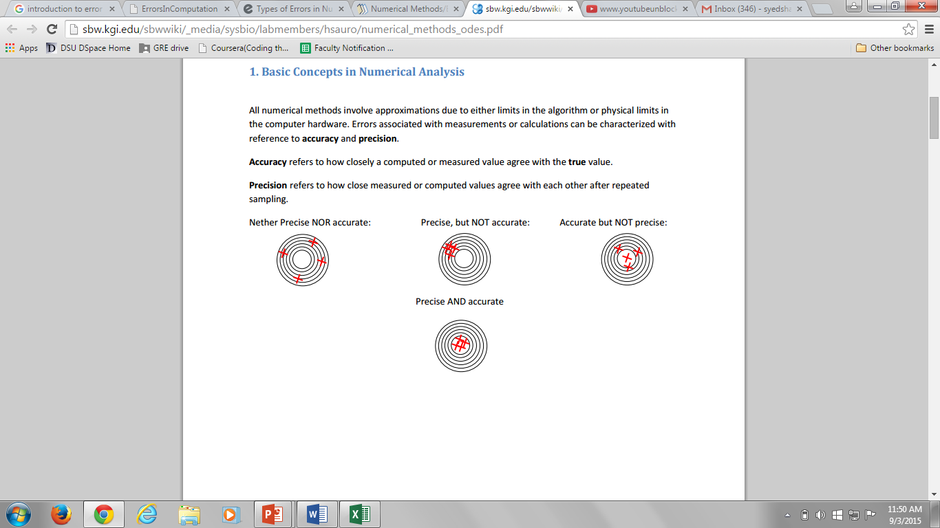

Slide 33
Rounding and Chopping
Rounding: Replace the number by the nearest
machine number. OR
its impossible to represent all real numbers exactly on machine with finite
Rouoff Error: is difference between an approximation of number used in computation and its exact value
Error = True value – approximate value
Chopping: Throw all or drop the extra digits.

Slide 34
ERROR Analysis:
Truncation Error:
Are when an iterative method is terminated or mathematical procedure is approximated and
Approximate soln differs from exact soln
Discretization Error :
are committed when a soln of discrete problem does not coincide with soln of continuous problem

Slide 35
Round vs Chop
√2 =1.414213562373095048801168872
∏ = 3.141592653589793238462643383
∏round =3.1416
∏chop =3.1415

Slide 36
Error in CM – True Error
Can be computed if the true value is known:

Slide 37
Error in CM – Estimated Error
When the true value is not known:

Slide 38
Notation
We say that the estimate is correct to n decimal digits if:
We say that the estimate is correct to n decimal digits rounded if:

Slide 39
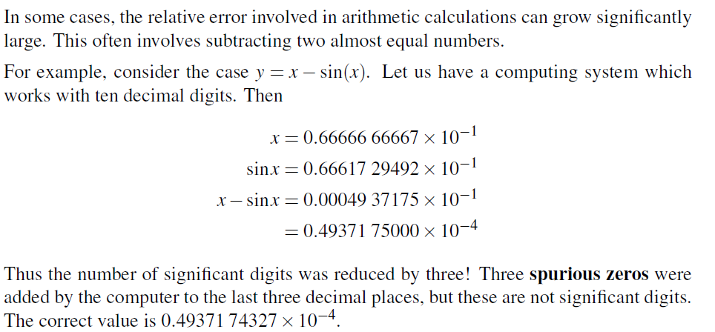
Loss of significance

Slide 40

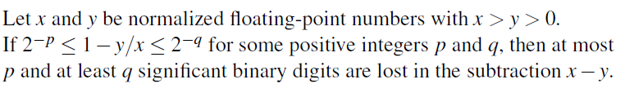
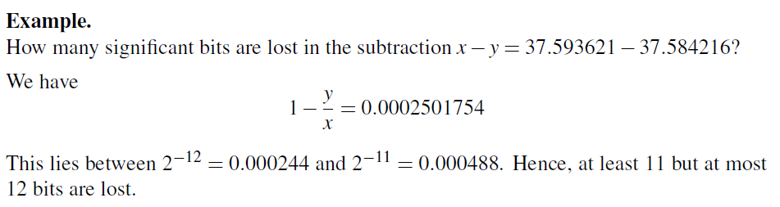

Slide 41
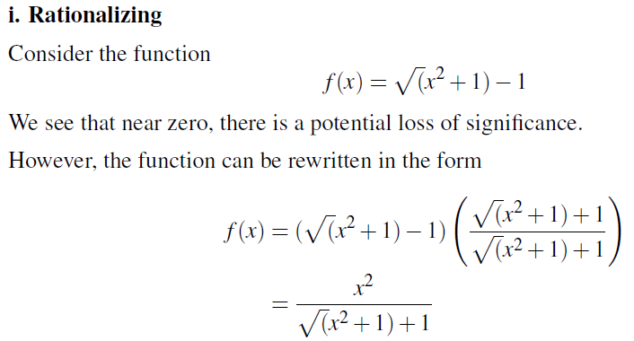
Avoiding loss of significance:

Slide 42
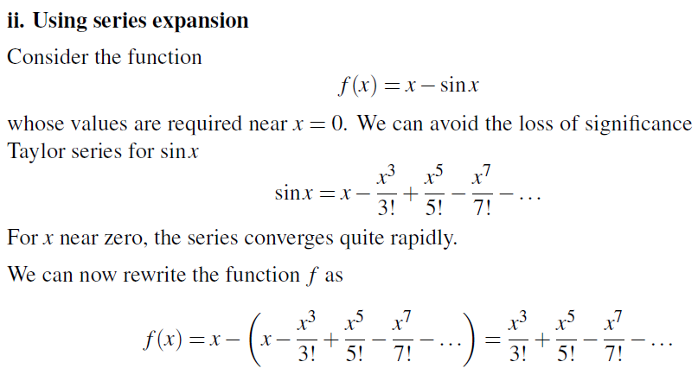

Slide 43
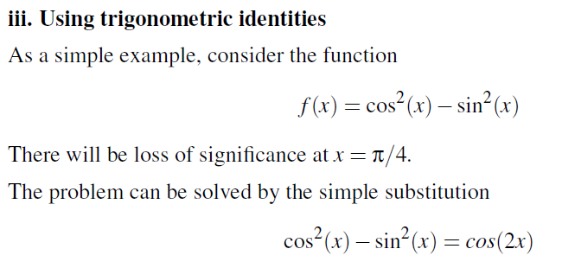

Slide 44
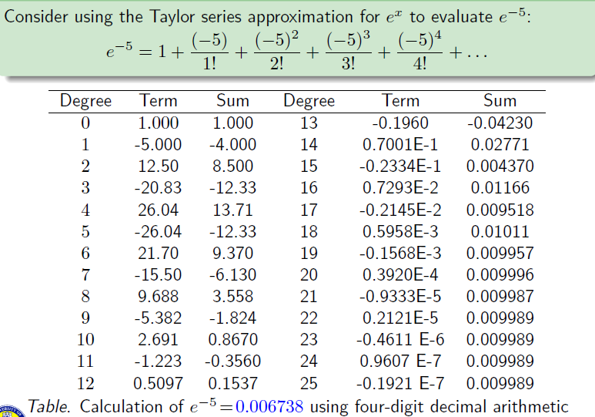

Slide 45
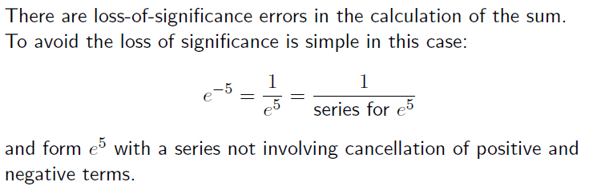

Slide 46
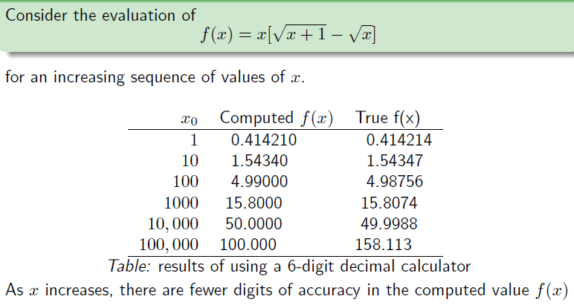

Slide 47
Commutative but not Associative
Consider a = 1234.567, b = 45.67834, c = 0.0004
(a + b) + c:
1234.567 (a)
+ 45.67834 (b)
____________
1280.24534 rounds to 1280.245
1280.245 (a + b)
+ 0.0004 (c)
____________
1280.2454 rounds to 1280.245 <--- (a + b) + c
a + (b + c):
45.67834 (b)
+ 0.0004 (c)
____________
45.67874
1234.567 (a)
+ 45.67874 (b + c)
____________
1280.24574 rounds to 1280.246 <--- a + (b + c)

Slide 48
Summary
Number Representation
Numbers that have a finite expansion in one numbering system may have an infinite expansion in another numbering system.
Normalized Floating Point Representation
Efficient in representing very small or very large numbers,
Difference between machine numbers is not uniform,
Representation error depends on the number of bits used in the mantissa.

Slide 49
Taylor Theorem
Motivation
Taylor Theorem
Examples

Slide 50
Motivation:
To introduce modern approximation techniques; to explain how, why, and when they
can be expected to work; and to provide a foundation for further study of numerical
analysis and scientific computing.

Slide 51
Remark
In this course, all angles are assumed to be in radian unless you are told otherwise.

Slide 52
Taylor Series

Slide 53
Maclaurin Series
Maclaurin series is a special case of Taylor series with the center of expansion a = 0.

Slide 54
Maclaurin Series – Example 1

Slide 55
Taylor Series Example 1

Slide 56
Maclaurin Series – Example 2

Slide 58
Maclaurin Series – Example 3

Slide 59
Maclaurin Series – Example 4

Slide 60
Example 4 - Remarks
Can we apply the series for x≥1??
How many terms are needed to get a good approximation???
These questions will be answered using Taylor’s Theorem.

Slide 61
Taylor Series – Example 5

Slide 62
Taylor Series – Example 6

Slide 63
Convergence of Taylor Series
The Taylor series converges fast (few terms are needed) when x is near the point of expansion. If |x-a| is large then more terms are needed to get a good approximation.

Slide 64
Taylor’s Theorem
(n+1) terms Truncated Taylor Series
Remainder

Slide 65
Taylor’s Theorem

Slide 66
Error Term

Slide 67
Error Term - Example

Slide 68
Taylor’s Theorem – Alternative forms

Slide 69
Example 7 – Taylor Series

Slide 70
Example 7 – Error Term

